Slide 1
The Job Search
Chapter: 16

Slide 2
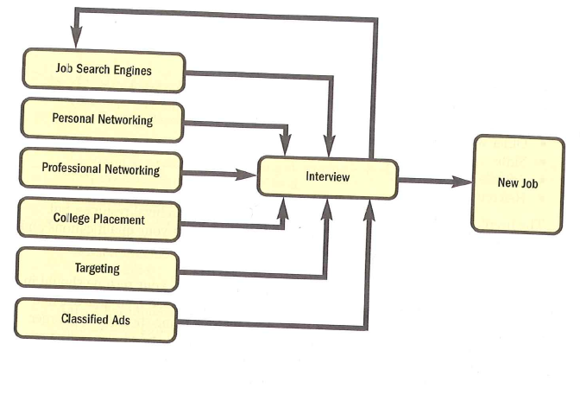
The Job Search Cycle

Slide 3
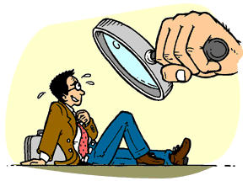
Responsibilities of a Job Applicant
Preparing for the Interview
Writing a cover letter
Include a resume
The Interview

Slide 4
Job Correspondence
Resumes and Job Application
Notes:
Most job letters and résumés are still sent through internet.
Your job application, no longer than one page, should be specific about the job you seek and your main selling points.
Then the résumé—one page or two at most—should simply, specifically, and neatly highlight your background.

Slide 5
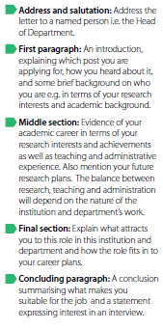

Format of a Cover Letter

Slide 6
Writing a Cover Letter
A job letter is just another type of sales letter – except that you are “selling” yourself, not a product or service.
A cover letter should include the following elements:
Where and how you found out about the position
Your reason for being interested in this company
Your main skills and accomplishments (summary of few key points)
How you fit the requirements for the job
Items of special interest about you that would relate to your potential for the job
Request for an interview
The letter should be one page or less. You should always include a resume with the letter.

Slide 7
ABC Format: Job Letters
Abstract
Apply for a specific job
Refer to ad, mutual friend, or other source of information about the job
Briefly state how you can meet the main need of your potential employer (optional)
Body
Specify your understanding of the reader’s main idea
Provide main qualifications that satisfy these needs (only highlight information from resume do NOT simply repeat all resume information)
Avoid mentioning weak points or deficiencies
Keep body paragraphs to six or fewer lines
Use a bulleted numbered list if it helps draw attention to three or four main points
Maintain the “you” attitude throughout
Conclusion
Tie the letter together with one main theme or selling point
Refer to your resume
Explain how and when reader can contact you for an interview

Slide 8
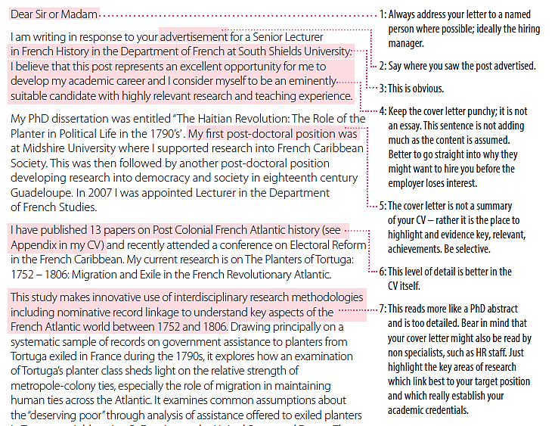
Example cover letter

Slide 9
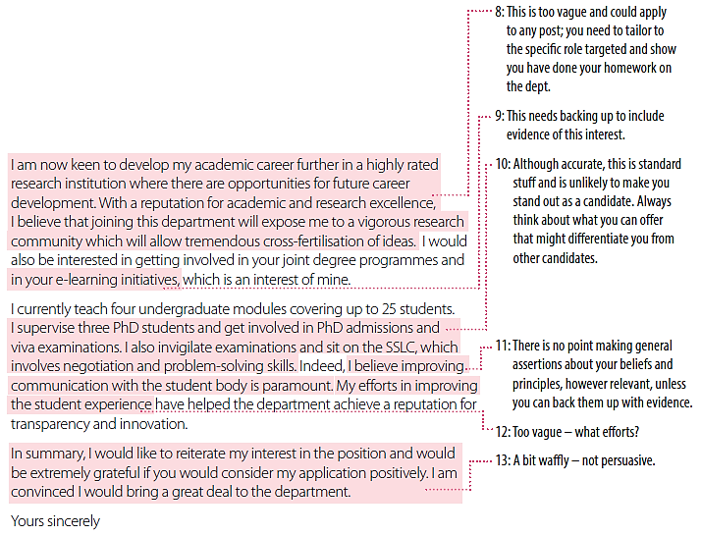

Slide 10

Cover Letter Do’s and Don’ts
Your cover letter—along with your c.v. and your letters of recommendation—will determine whether a search committee will pursue your candidacy. As many as half the applicants for a particular job are rejected after the search committee looks at the cover letter. The committee members may conclude that the candidate is not qualified for the job or that the applicant’s work is not engaging. In other words, it is crucial that your letter grab the committee’s interest.
Avoid common cover letter blunders:
DO address the letter to a specific individual.
DO be concise. This is not the place for an overly lengthy discussion of your dissertation.
DON’T be too lengthy. Generally one or two pages is sufficient.
DON’T use hyperbole. Be professional in tone.

Slide 11

Don’t:
Try to summarise your CV or give too much detail – you need to be selective about the points that you highlight
Make unsubstantiated statements about relevant skills and experience without giving examples
Send the same or a similar letter to more than one employer. Never ‘cut and paste’ as employers will suspect a lack of research and career focus
Make generalised statements about why you want to work for the institution (e.g. referring to ‘a top 50 global institution’ or ‘a department with a high reputation’)
Use jargon specific to your employer or profession which the employer might not understand
Focus on what the employer can do for you – it’s moreabout what you can do for the employer.

Slide 12
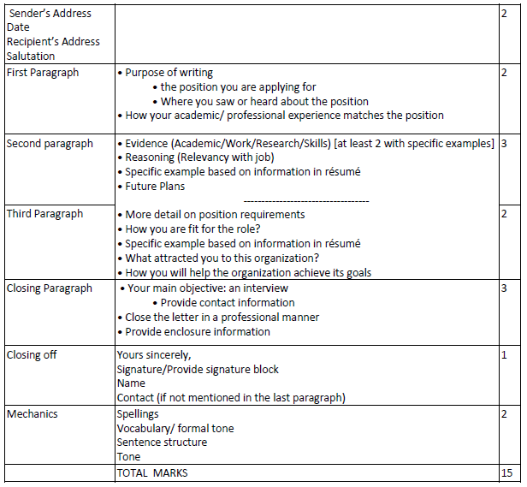
Cover Letter Rubric

Slide 13
Include a Resume
The resume, a summary of your skills and accomplishments, is your “silent sales representative”
In writing a resume, include the following information:
Contact information: Your name, address and telephone numbers at which you can be reached, your email address
Job Objective: A precise, clear sentence about your specific area of expertise
Example: To use my intellectual abilities, quantitative knowledge, communication skills, and proven leadership ablility creatively to further the organizational mission of a high integrity marketing research organization.
Employment History: paid and nonpaid experiences, beginning with the most recent.be sure to give employment dates, and briefly list important duties and accomplishments.
Education: Schools attended, degree completed
Relevant professional certifications and affiliations: Memberships, offices held
Special skills: Fluency in foreign languages, computer expertise
Interests and activities: only those that are related to your objectives
References: People who know your work, your capabilities, and your character who will vouch for you. Include only a statement that references are available on request.

Slide 14
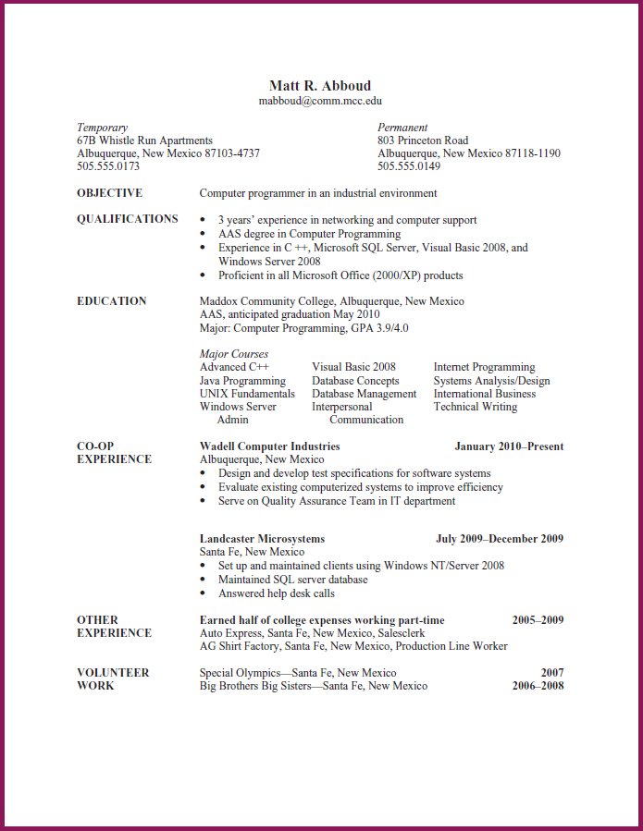

Slide 15
Looking at the resume for ten seconds. What do you remember? In other words, what stands out?
Does the resume look balanced and attractive? Explain.
What information is included in each major section?
How does Matt’s work experience relate to his job objective?
What impression does his earning some of his college expenses make?
What kind of impression does his volunteer work make?
Notes:
A successful, job letter or résumé is the one that gets you an interview. After that, your interpersonal skills help you land the job.

Slide 16
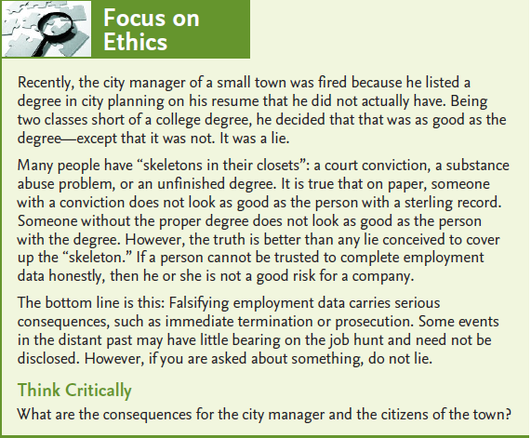

Slide 17
TASK 1: Who I am and How I know This
1. First ask yourself, How do I see myself? List the skills, abilities, knowledge, competencies, and personality characteristics that describe how you see yourself. To generate this list, try completing the sentences: “I am skilled at . . . ,” “I have the ability to . . . ,” “I know things about . . . ,” “I am competent at doing . . . ,” and “One part of my personality is that I am . . . .” List as many characteristics in each category as you can think of. What you have developed is an inventory of your self-concept. Second ask, How do others see me? List the skills, abilities, and so on that describe how you think others see you by completing the sentences: “Other people believe I am skilled at . . . ,” “Other people believe I have the ability to . . . ,” “Other people believe I know things about . . . ,” “Other people believe I am competent at doing . . . ,” and “One part of my personality is that other people believe I am . . . .” Compare your two lists. How are they similar? Where are they different?
2. Under the following headings, fill in information about yourself:
Qualification: Degree, Institute, name
Work Experience: nature of work, name of company, date (year
Professional skills

Slide 18
TASK 2:
Prepare your résumé. If you already have a résumé, revise it to follow this chapter’s guidelines.

